Slide 1
Automated Web Fuzzing with Wfuzz
ECE653 Project Presentation
Speaker: Jiahao Shi
Group members: Xinyi Ma, Shuoyuan Chen
Date: 2020.08.23

Slide 2
AutoWfuzz
Automation of Wfuzz
Scan webs for vulnerabilities:
Potential leak of information (files/dir with common names)
Weak password
SQL injection
XSS injection

Slide 3

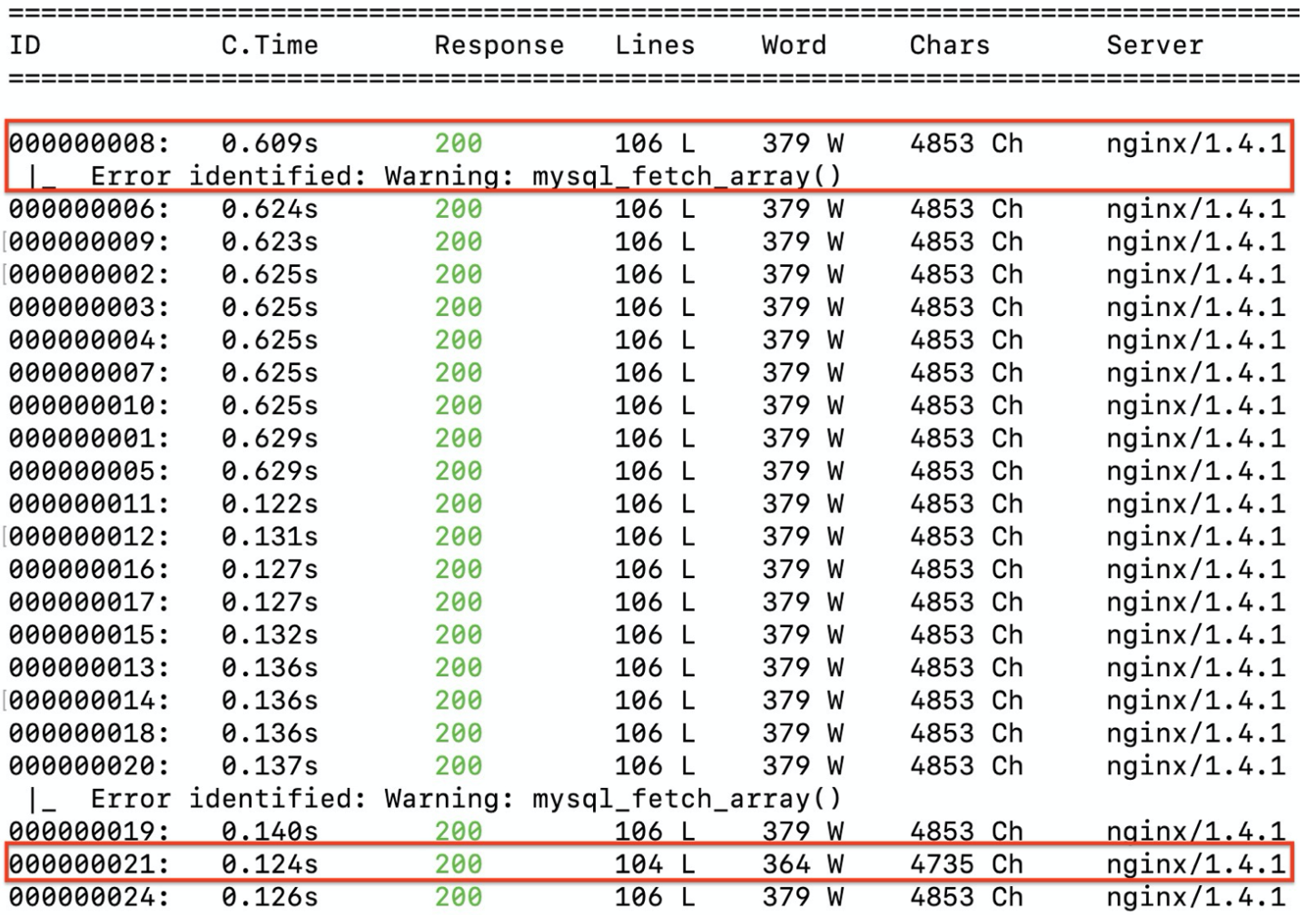
Wfuzz
wfuzz -z file,wordlist/SQL.txt --hc 404 http://testphp.vulnweb.com/listproducts.php?cat=FUZZ
payload
filter
URL
param
Characteristics
Fuzz on URL / POST parameter
Filter output
Plugins: error detection
AutoWfuzz: Improvement on outputs
Clustering based on code, lines, word, chars
Error detection, search for
Mysql_fetch_array()
Error 1064
Error 1054

Slide 4
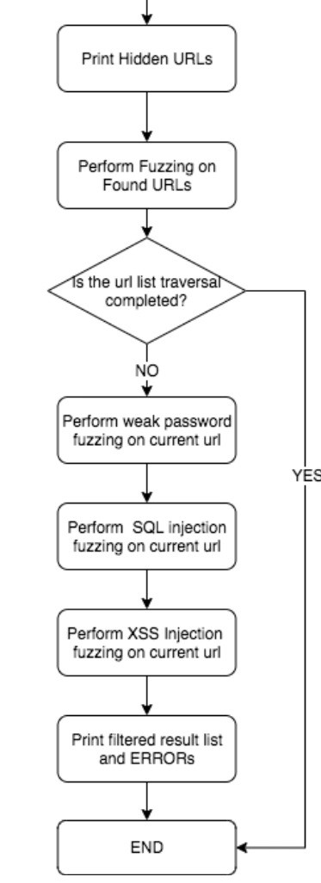
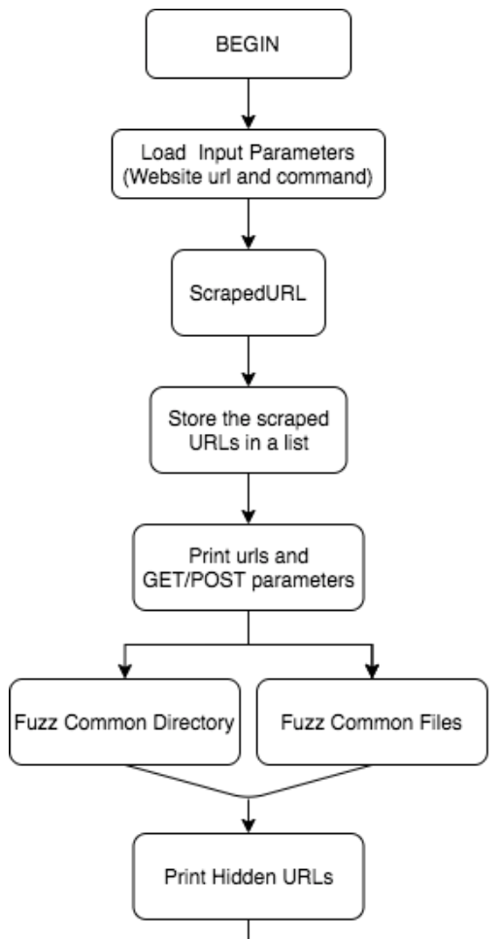
Fuzzing Steps

Slide 5
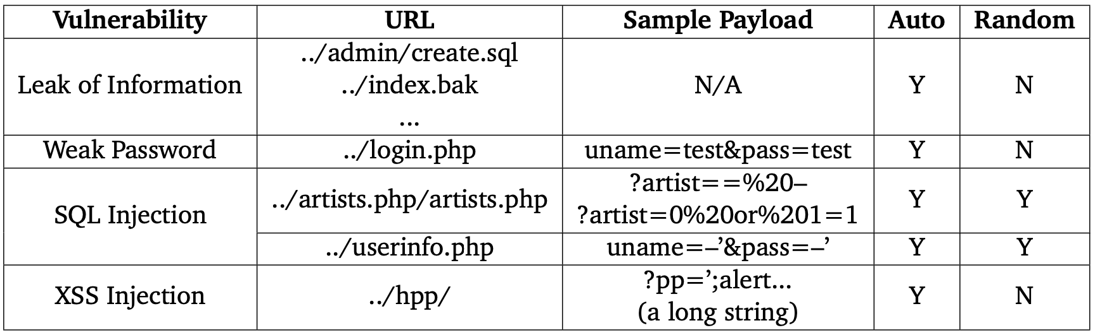
Experimental Results
testphp.vulnweb.com

Slide 6
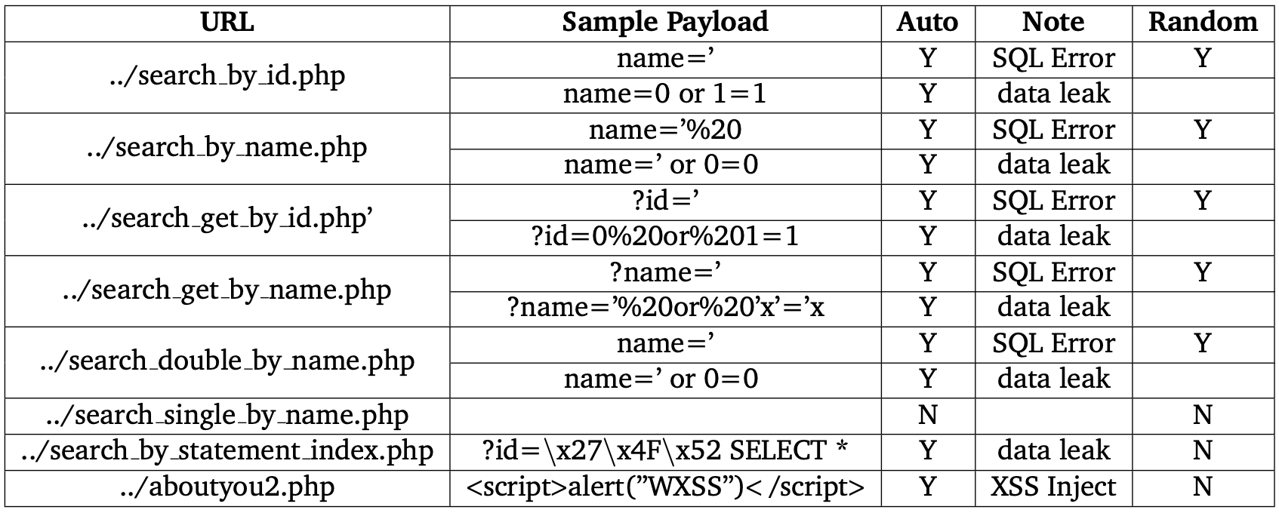
Experimental Results
www.webscantest.com
SQL Injection
XSS Injection

Slide 7
Compared to Random Fuzzer
Customized random fuzzer
Web scraper
Random input generator
numbers, words, strings with symbols and punctuations
Used as payload of Wfuzz
testphp.vulnweb.com

Slide 8
Compared to Random Fuzzer
Customized random fuzzer
Web scraper
Random input generator
numbers, words, strings with symbols and punctuations
Used as payload of Wfuzz
www.webscantest.com

Slide 9
Conclusion
Automatically search for vulnerabilities
High coverage
Efficient (takes a few minutes to scan a website)
Demo

